Slide 1



ADA PROJECT SYNOPSIS
MODELING AND ANALYSIS OF
KINGHT TOUR PROBLEM
Under the guidance of
Dr. Vani Priya C H

Slide 2
Knight’s Tour Problem
Details of Group Members:-
USN | NAME | SEMESTER | BRANCH
1MV19IS015 | LAHARI C | 4 | ISE
1MV19IS039 | NEHA S G | 4 | ISE
1MV19IS044 | PRATHAM PAI BM | 4 | ISE
1MV19IS062 | VAISHNAVI R | 4 | ISE

Slide 3
INTRODUCTION
To solve the Knight’s tour problem we use an algorithmic technique known as Backtracking ,Data Structures used are 2-D Arrays and Recursion
Backtracking can be defined as a general algorithmic technique that considers searching every possible combination in order to solve a computational problem.

Slide 4
TYPES OF BACK TRACKING PROBLEMS
There are three types of problems in backtracking-
Decision Problem –In this,we search for a feasible solution.
Optimism Problem- In this, we search for the best solution.
Enumeration Problem- In this, we find all feasible solutions.

Slide 5
KNIGHT’S TOUR PROBLEM
Chess problem involving a knight
Start on a random square
Visit each square exactly ONCE according to the rules
Tour is called closed if the ending square is same as the starting square otherwise it is known as a open tour.

Slide 6
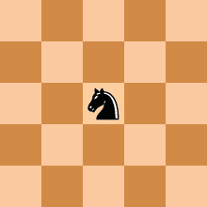
PROBLEM DEFINITION
Given a N*N board with the Knight placed on the first block of an empty board. Moving according to the rules of chess knight must visit each square exactly once. Print the order of each the cell in which they are visited.

Slide 7
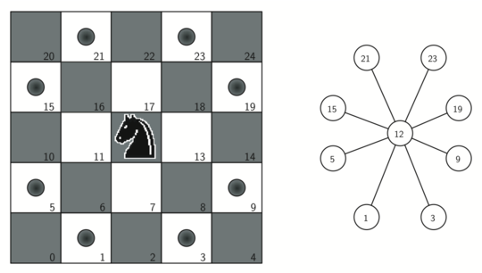
POSITIONS THE KNIGHT CAN MOVE

Slide 8
LITERATURE SURVEY
TAN CHI WEE, NUR HAFIZAH GHAZALI, GHAZALI BIN SULONG “A NEW STRUCTURED KNIGHT TOUR ALGORITOM BY FOUR KNIGHT’S WITH HEURISTRIC PRESET RULES” PUBLISHED IN ACADEMIA JOURNALS OF TELECOMMUNICATION,ELECTRONIC AND COMPUTER ENGINEERING .
This proposed method suggests an Algorithm that able to cater Knight Tour Problem with shorter execution time by using three heuristic preset rules.
Preset Rule 1:Knight only allowed to move outward against margin or outer square of the chessboard(if possible).
Preset rule 2:Knight only allowed to make a swerve at corner of a chessboard without bouncing back to the direction where it comes from.
Preset rule 3:Knight only allowed to move to another square with respect to structural knight Tour as illustrated at Figure 2, in other words, only one choice for Knight when it comes to other corner square.

Slide 9
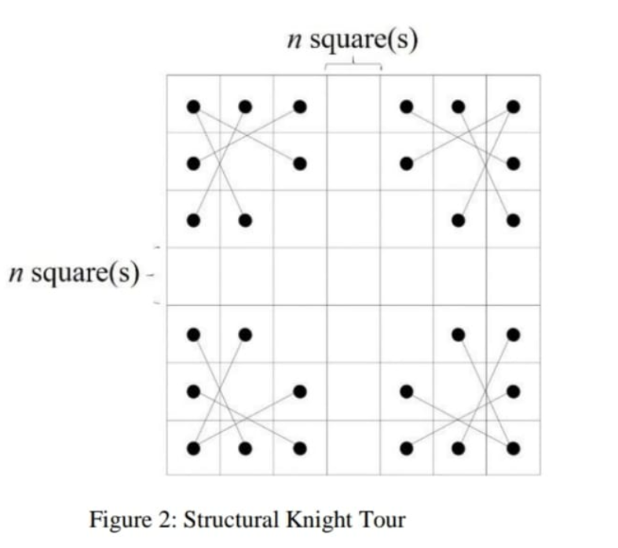
STRUCTURAL KNIGHT TOUR:
The execution time for a completely closed Knight Tour able to be generated in a very abbreviated time. Further, this algorithm able to solve Knight Tour in a huge board size larger than 500 which is not achieved by most of the researcher.

Slide 10
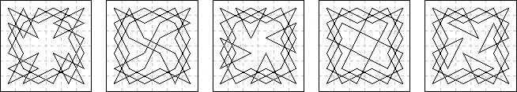
KNIGHTS TOUR VARIATION
There are just 5 distinct closed knight tours with quaternary symmetry on the 6×6 board.
Found by Paul de Hijo (Phillipe Jolivald) 1882 and independently rediscovered many times since.

Slide 11
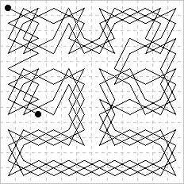
The simplest of the four diagonal magic
knight tours on the 12 by 12 board
found by Awani Kumar in 2003.

Slide 12
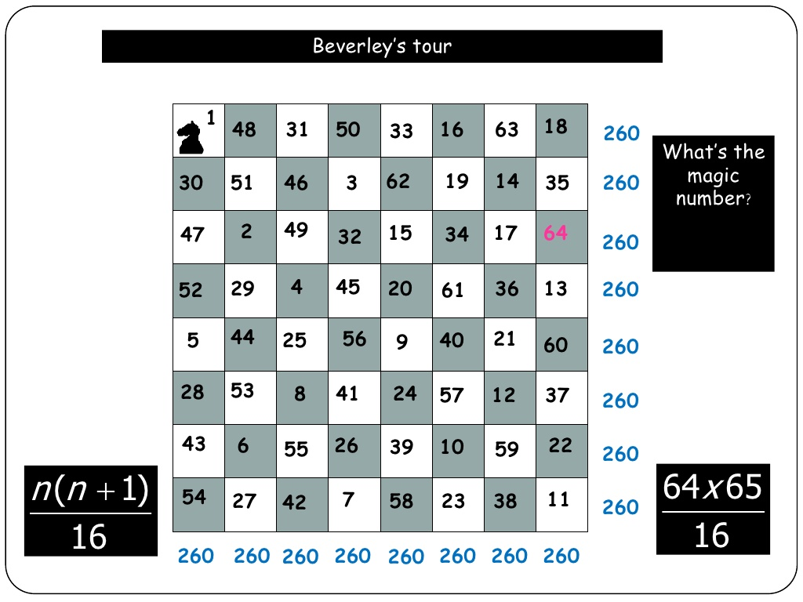
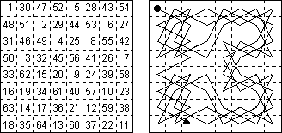
MAGIC KNIGHTS TOUR:
The tour is called as such if the resulting arrangement of numbers is a magic square. Semi magic square if diagonals don’t add up to magic sum
The first semi magic knight's tour for an 8x8, found by William Beverley, was published in 1848
In August 5, 2003, after nearly 62 computational days, a search showed that no 8x8 fully magic knights’s tour is possible.

Slide 13
WARNSDORFF’S ALGORITHM FOR
KNIGHT’S TOUR PROBLEM
Warnsdorff’s Rule:
In 1823 Warndorff proposed a simple rule which he suggested gave a tour on the 8x8 chessboard.
Warndorff’s rule: Construct a knight’s path, Let the (n+1)th square of the path be the square which:
1. Is adjacent to the nth square
2. Is unvisited
3. Has the minimal number of adjacent unvisited squares
Should more than one square satisfy these three conditions, the tie may be broken at random, should no squares satisfy the conditions, the path terminates.

Slide 14
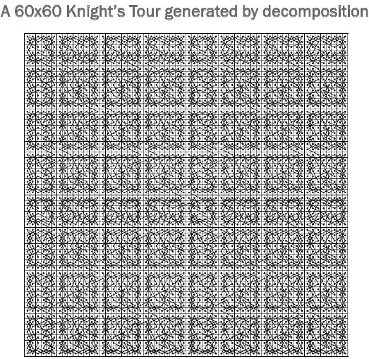
IMPROVEMENTS BY DECOMPOSING:
Decompose a large board into smaller rectangles.
Solve these sub rectangles.
Join the smaller solutions.
It can fail for boards larger than 76x76.

Slide 15
WARNSDORFF’S ALGORITHM:
Set P to be a random initial position on the board
Mark the board at P with the move number “1”
Do following for each move number from 2 to the number of squares on the board:
  let S be the set of positions accessible from P.
  Set P to be the position in S with minimum accessibility
  Mark the board at P with the current move number
Return the marked board — each square will be marked with the move number on which it is visited.

Slide 16
AN EFFICIENT ALGORITHM FOR THE KNIGHT’S TOUR PROBLEM
An efficient algorithm for the Knight’s tour problem by Ian Parberry Department of Computer Sciences, University of North Texas, USA
An n x n chessboard has a closed knight’s tour iff n Z 6 is even, ’ and an open knight’s tour iff n 3 5
We use Divide and Conquer Algorithm to find the Knight’s tour
For all even n > 6 there exists u structured knight’s tour on an n x n and an n x (n + 2) board. Such a tour can be constructed in time 0(n2).
For all even n > 6 there exists u structured knight’s tour on an n x n and an n x (n + 2) board. Such a tour can be constructed in time 0(n^2).
The new algorithm can be used to find highly structured knight’s tours (specifically, quadrisected tours and tours that are symmetric under rotations), and is amenable to implementation as efficient parallel algorithms under various architectures.

Slide 17
DESIGN_BACKTRACKING
The main technique used is the Backtracking Algorithm –
Each cell from the beginning will be traversed in a particular order by the knight.
Once a square is valid, we jump onto the next corresponding cell and continue the same until the complete tour is finished.
At some point if the square is not valid, which happens if there would still be squares leftover but not traversable, then we move back since our previous knight move was wrong there will be a violation.
This contains various recursive functions, when there is a violation, the control moves back to its previous recursive function and tries a different knight move.
Hence in short, moving "back" when there is a violation, and moving "forward" again until the tour is completed.

